Slide 1
COMP 2920 : Software Architecture & Design

Slide 2
Chapter Topics
What use case modeling is and is not.
The four components of a use case.
The basic elements of use case diagram.
How to transform concepts from domain analysis into use cases.
Identifying prominent actors.
Identifying major use cases.
The context diagram.

Slide 3
Use Case Modeling
Use cases model the behavior of a system
A use case is a unit of system behavior
A use case is a contract that formalizes the interaction between stakeholders and the system
A use case details the interaction of an actor with a system to accomplish a goal of value to the actor
Use cases are technology-independent

Slide 4
What Use Case Modeling Is Not
Use Case modeling is limited to a system’s external behavior
Use cases do not model the system from inside.
Use cases are not effective in capturing the non-functional requirements.
Use case modeling is not the same as functional decomposition.
Use cases are not inherently object-oriented.
Use cases describe what a system accomplishes, not how.

Slide 5
Components of Use Cases
A use case has four components:
A goal,
Stakeholders,
A system, and
A scenario.

Slide 6
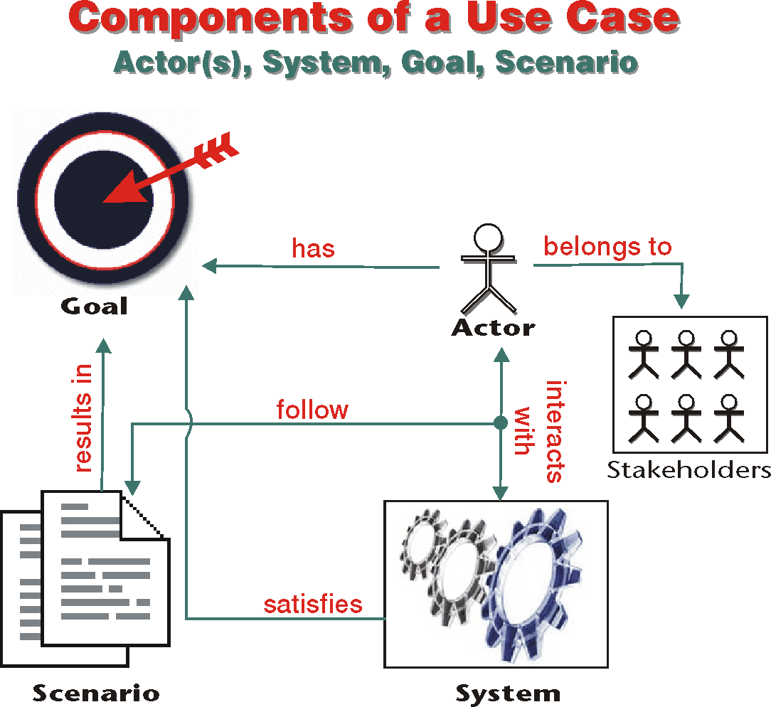

Slide 7
Goal
A use case is successful only if its stated goal is completely achieved
A use case’s name is its goal. The name must be active, concise and decisive.
It is the goal that decides the relevance of activities in a use case.

Slide 8
Stakeholders and Actors
Stakeholders are those entities whose interests are affected by the success or the failure of the use case.
An actor is an entity outside the system that interacts with the system to achieve a specific goal.
A use case must enforce the interests of all stakeholder.

Slide 9
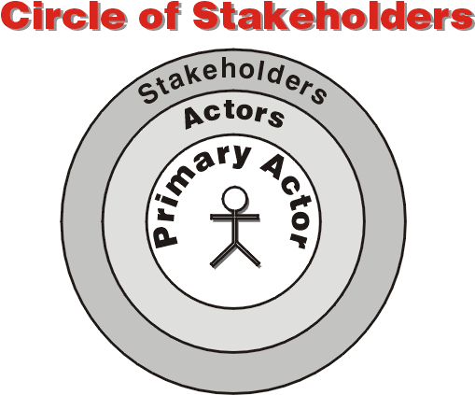

Slide 10
Actor
Actor is a role that any user who has been given the part can play.
The goal of the primary actor is specified by the name of the use case.
Supporting (or secondary) actors support the primary actor in reaching the goal of the use case.
An actor is identified by a unique name which describes a unique role.

Slide 11
A System
The system defines the boundaries of a use case
Two types of systems
Real system
Grocery store “bricks-and-mortar”
Information system
Point of Sales System (POS)
A use case cannot leave a system, but can reach across its boundaries

Slide 12
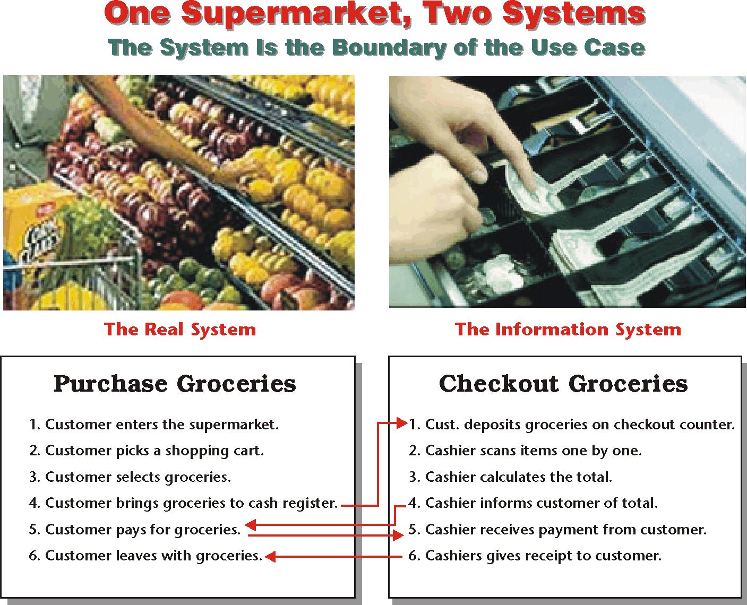

Slide 13
Purchase Groceries — The Real System Scenario
A customer enters the supermarket. The customer takes a shopping cart or basket and strolls through the supermarket. The customer selects items from the shelves and puts them in the shopping cart or the basket. When finished, the customer brings the items to the cash register. The cashier calculates the total price of the merchandise. The customer pays for the merchandise. The cashier bags the items, issues a receipt to the customer and, if necessary, returns the change. The customer picks up the bags and leaves the supermarket.

Slide 14
Purchase Groceries — The Point-of-Sale System
The customer deposits groceries on the checkout counter. The cashier scans each item and deposits the item on the bagging counter. When the last item is scanned, the cashier reads the total amount from the system and announces it to the customer. If the customer pays by credit card, the cashier swipes the card through the cash register to charge the amount. The customer then signs the printout. If the customer pays by cash, the cashier returns the change, if any. The cashier then gives a receipt to the customer.

Slide 15
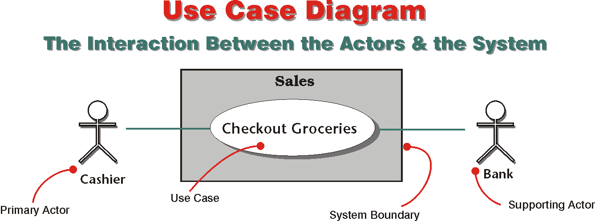

Slide 16


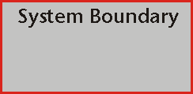
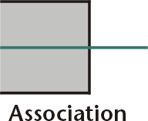
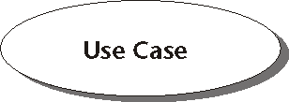
 | The stick figure identifies an actor. More than one actor can be associated with a use case, and one actor can be associated with more than use case.
 | The rectangle is the system boundary or the scope. For the use case, any entity outside this boundary can exist only as an actor.
 | The ellipse (the oval) represents the use case. It resides inside the system boundary. In the diagram,
 | The simple line on the left represents association. It shows the communication between an actor and a use case.

Slide 17
A Scenario
The scenario is an ordered sequence of interactions between the actor(s) and the system to accomplish a goal. It consists of:
Normal Flow
Alternate Flow
Sub-Flows
Exceptions

Slide 18
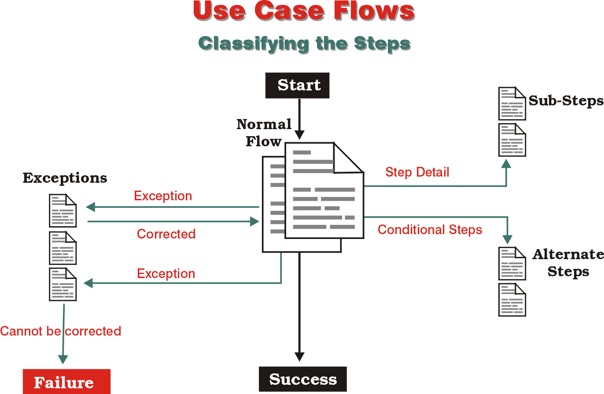

Slide 19
Steps in a Use Case Scenario
Steps can be repeated
One step or a set of step can be repeated until a certain condition is met. In Checkout Groceries, the cashier scans purchase items until there are no more groceries are left to scan.
A step can call on another use case
Each step may call on another use case to complete its function.
A step is a transaction
Each step appears as just an interaction, but it is really a transaction between the actor and the system. That means that in each step:
the actor sends a request to the system,
the system validates the request,
the system changes its state as a result of validation, and then
the system responds.

Slide 20
Use Cases in the Modeling Spectrum
Use cases reside near the dynamic edge of the modeling spectrum.

Slide 21
Develop Initial Use Cases
Components of use case modeling are provided by analyzing and expanding concepts that result from domain analysis.
Use cases straddle two worlds: the language-driven world of requirements and the structured world of models.

Slide 22
Patient Management in Hospital: Milestones
Business Analysis.
The business analyst must conducted a broad-based study of Medical Center’s business.
Problem Definition.
the business analyst identified and scoped the problems that the hospital must solve to save its sagging business.
Propose Solutions.
The analyst proposed a capital project for improving all aspects of hospital’s operations and infrastructure.
Project Initiation.
The hospital charged its newly hired CIO with the task of planning an IS strategy for the medical center.
Domain Definition.
Business domains that need the services of an information system are: Patient Management, Medical Records Management, Legal, Drug Inventory & Purchasing, Transportation, Accounting, and many more.
Domain Scoping.
The hospital decided that the Patient Management domain must have the highest priority.
Domain Analysis & Domain Dictionary.
Within the scope of Patient Management, business concepts were explored, defined, and organized into a preliminary domain dictionary.

Slide 23
Identify Prominent Actors
The primary candidates for becoming actors are domain concepts classified as “role.”
Discovering actors is a process of consecutive abstraction.

Slide 24
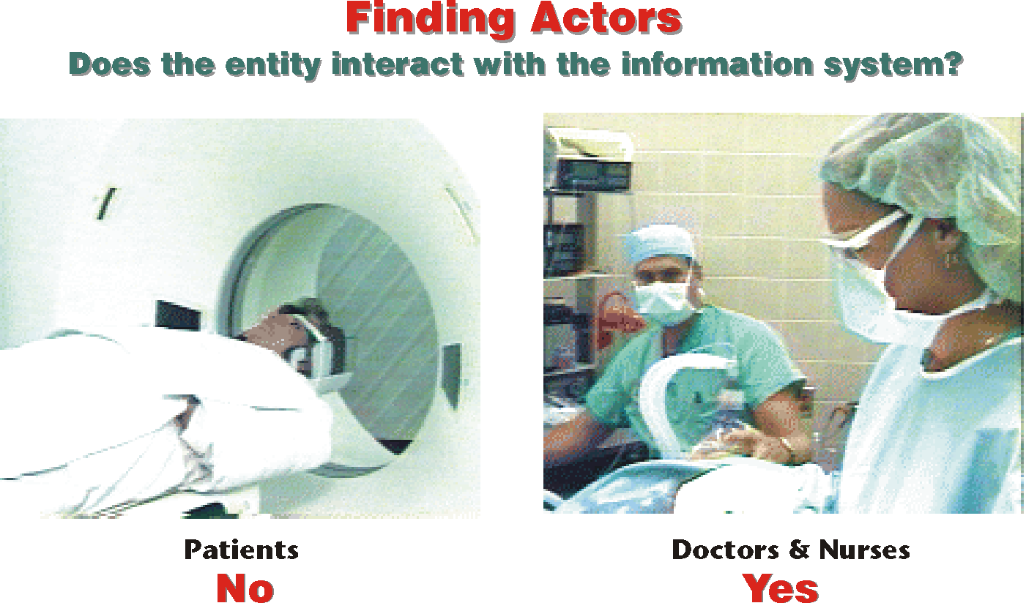

Slide 25
Patient Management: Domain Dictionary
Name | Description
Appointment Clerk | Makes appointments for the patient.
Billing Clerk | Produces individual patient bills on request; records payments; resolves billing issues.
Doctor | Provides a specialized level of medical services to the patient: diagnosis, procedures and operations, prescriptions and monitoring of medical conditions.
Emergency Medical Worker | Refers the patient to the emergency room. Performs emergency medical services before emergency room.
Lab Technician | Performs a test medical service: X-ray, blood test, MRI, etc.
Medical Staff | Any person who provides a medical service to a patient: a doctor, a nurse, a lab technician, or an emergency medical worker.
Nurse | Helps the doctor in providing medical services. Administers drugs and monitors the patient.
Outside Hospital | Refers patient for an appointment and medical service.
Primary Care Physician | Refers the patient to the hospital to receive medical services.
Referral Source | A primary care physician, an emergency medical worker or an outside hospital that refers a patient for an appointment to receive a medical service. Patient himself or herself can be a referral source.
Registration Clerk | Performs registration.

Slide 26
Identify Major Use Cases
Major use cases are identified by analyzing business processes and functions
❶ Take Apart
❷ Join

Slide 27
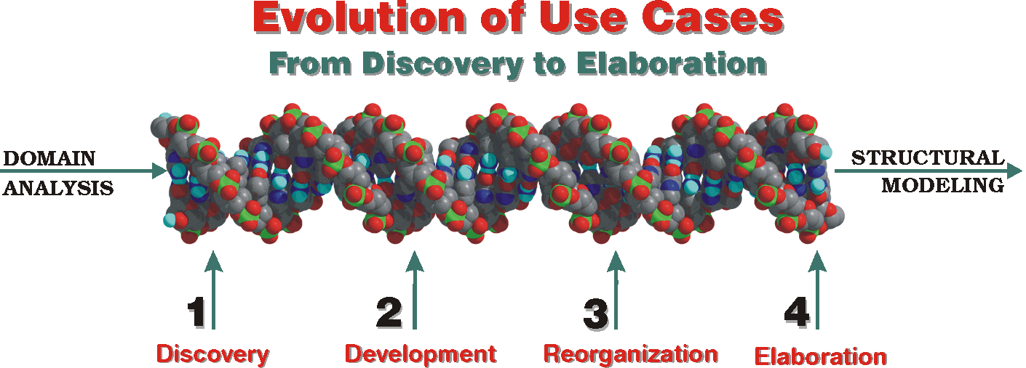
Next: Developing Use Cases

Slide 28
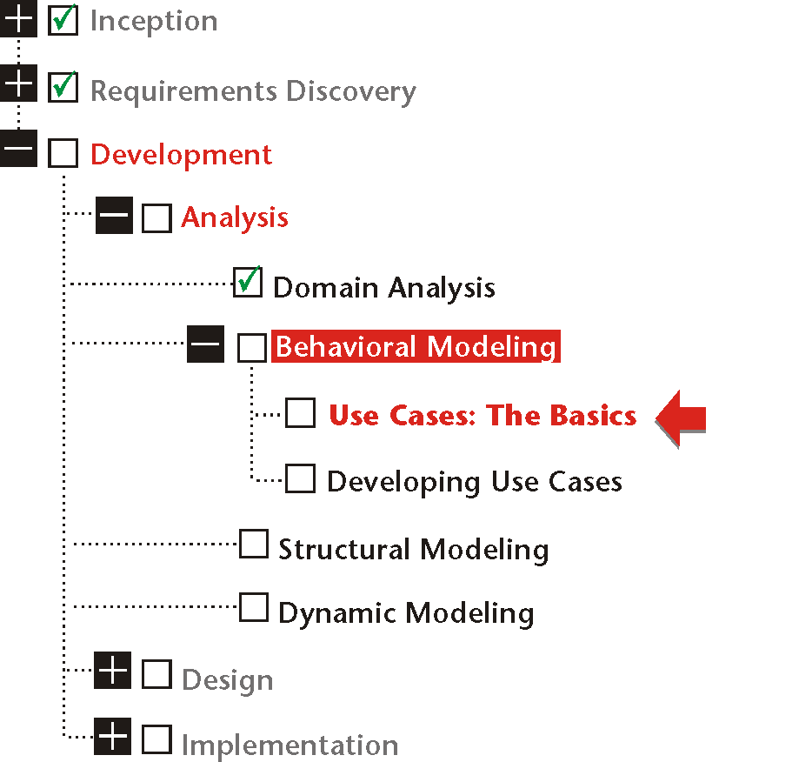

Slide 29
